Slide 1

INSURANCE POLICY MANAGEMENT
GROUP 2

Slide 2
Team Members
Employee Id | Name
2563074 | Ashish Chaudhary
2564494 | Bolli Sindhu
2563020 | Manasa Rajagopal Madabushi
2564260 | Ravipati Harshitha
2562980 | Theertha T
2564188 | Bachu Sripathi
2564578 | Harshavardhan K
2563423 2563128 2563181 | Kanna Kaveri N P Srisakthikumar Nalam Anantha Lakshmi

Slide 3
INDEX
Introduction
Project Scope
Tools & Technologies
UML Diagrams
Admin Module
User Module
Output
Conclusion

Slide 4
INTRODUCTION
Insurance Policy Management System is a web application which is used to tracking the details about the insurance policy, customer details and company details.
This project is useful for any kind of insurance company to manage the insurance details, to sanctioned the insurance for customer, process the insurance policy details and all kind of insurance process through online.
In this online process the user enter into the website it will show details about insurance and its types, also it will show the details about different duration schemes to the corresponding insurance type or insurance policy.
In this process contains the user registration form which is used to apply for insurance policy through online.
It also helps the customer to view their own insurance status information.
If the policy holder wants to view the information about their own policy details, he/she login to policy status page by using the policy holder ID and password had already given by insurance company.

Slide 5
PROJECT SCOPE
The system is convenient and flexible to be used, it saves their time, efforts, money and resources.
This insurance management system can efficiently manage the company records, provides instant access and improves productivity.
The system is used to keep the record of policy details, customers details.
This system is used to provide online services to its member organizations.
Option to create a new policy for any existing/new client.
Option to edit the contact information of its client.
This system provides information about new policies or existing polices through online.
All communication happens via email, which are faster and more reliable than courier or post.

Slide 6
SERVICE DIVISION
KANNA KAVERI
ADMIN LOGIN
ADD ADMIN
UPDATE ADMIN
DELETE ADMIN
VIEW ADMIN
ANANTHA LAKSHMI
ADD CUSTOMER
VIEW ALL CUSTOMER
COUNT CUSTOMER
HARSHITHA
UPDATE CUSTOMER
DELETE CUSTOMER
SRISAKTHIKUMAR
ADD POLICY
COUNT POLICY
GET SPECIFIC POLICY
THEERTHA T
VIEW ALL POLICY
UPDATE POLICY
DELETE POLICY
BOLLI SINDHU
VIEW QUESTION
REPLY QUESTION
MANASA
ASK QUERY
VIEW QUERY
DELETE QUERY
HARSHAVARDHAN
VIEW POLICY APPLICATION
APPLY POLICY
VIEW STATUS
GET POLICY BY STATUS
ASHISH
APPROVE/REJECT POLICY
DELETE POLICY
COUNT OF POLICY
BACHU SRIPATHI
ASK QUESTION
VIEW REPLY

Slide 7




TOOLS & TECHNOLOGIES
Server-side: Spring Boot, Spring Cloud, Spring Data JPA
Database: MySQL
Server: Embedded Tomcat
DevOps: Docker, GitHub
Spring Cloud: Spring Cloud Config, Spring Cloud Netflix Eureka, Feign, Resilience4j, Retry, Sleuth and Zipkin

Slide 8
What are Microservices?
Microservices is also known as the microservice architecture
It is an architectural style that structures an application as a collection of services that are
Highly maintainable and testable
Loosely coupled
Independently deployable services
Organized around business capabilities
Owned by small team

Slide 9
Characteristics of Microservice Architecture
Componentization via services
Organized round Business Capabilities
Products not Project(“you build, you run it”)
Smart endpoints and dumb pipes
Decentralized Data Management
Infrastructure Automation
Design For Failure

Slide 10
Server-Side:
Spring Boot:
Spring Boot is an open-source Tools. Spring Boot is a project that is built on the top of the Spring Framework.
It provides an easier and faster way to set up, configure, and run both simple and web-based applications.
Spring Data JPA:
It aims to significantly improve the implementation of data access layers by reducing the effort to the amount that's actually needed.
Spring Data JPA provides repository support for the Jakarta Persistence API (JPA). It eases development of applications that need to access JPA data sources.

Slide 11
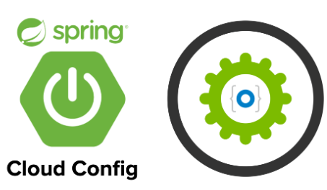
Spring Cloud:
Spring cloud provides tools for developers to quickly build some of the common patterns in distributed systems (e.g., configuration management, service discovery, circuit breakers, intelligent routing, micro-proxy, control bus, one-time tokens)
Spring cloud focuses on providing good out of box experience for typical use cases and extensibility mechanism to cover others
Distributed/Versioned configuration
Service registration and discovery
Routing
Service to service calls
Circuit Breakers

Slide 12
Spring Cloud Config Server
The Spring Cloud Config server is an externalized configuration server in which application and services can deposit access and manage all runtime configuration properties.
The Spring config server also supports version control of the configuration properties.
The Spring Config server stores properties in version-controlled repository such as Git or SVN. The Git repository can be local or remote. A highly available remote Git server is preferred for large scale distributed microservice deployments.

Slide 13
Spring Cloud Netflix Eureka
Spring Cloud Netflix provides Netflix OSS integrations for Spring Boot apps through auto-configuration and binding to the Spring Environment and other Spring programming model idioms.
With a few simple annotations, you can quickly enable and configure the common patterns inside your application and build large distributed systems with battle-tested Netflix components.
The patterns provided include Service Discovery (Eureka).
Eureka is the Netflix Service Discovery Server and Client.
The server can be configured and deployed to be highly available, with each server replicating state about the registered services to the others.

Slide 14
Spring Cloud Feign
Feign is a Spring Cloud Netflix library for providing a higher level of abstraction over REST-based service calls.
Spring Cloud Feign offers a declarative approach for making RESTful service-to service call in a synchronous way.
When using Feign, we write declarative REST services at the client, and use those interfaces to program the client.

Slide 15
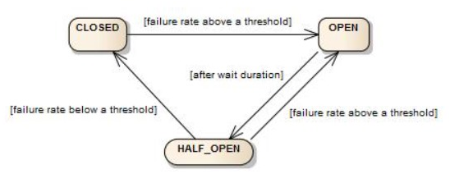
Spring Cloud Resilience4j
Resilience4j is a lightweight fault tolerance library designed for functional programming that provides a variety of fault tolerance and stability patterns to web application.
Resilience4j provides higher-order functions (decorators) to enhance any functional interface, lambda expression or method reference with a Circuit Breaker, Rate Limiter, Retry or Bulkhead.

Slide 16
Zipkin
Zipkin is a very effective tool for distributed tracing in the microservices ecosystem.
Distributed tracing, in general, is the latency measurement of each component in a distributed transaction where multiple microservices are invoked to serve a single business use case.
Distributed tracing is useful debugging when lots of underlying systems are involved, and the application becomes slow in any situation.
It manages both the collection and lookup of this data. To use Zipkin, applications are instructed to report timing data to it.

Slide 17
Sleuth
Sleuth is another tool from the Spring cloud family.
It is used to generate the trace id, span id and add this information to the service calls in the headers, so that it can be used by tools like zipkin and ELK etc. to store index and process log files.

Slide 18
POSTMAN:
The Postman testing tool is a complete API development platform with various built-in tools that support every stage of the API lifecycle. Postman is an API client that makes it easy for developers to create, share, test and document API.
MySQL:
MySQL is an open source relational database management system.(RDMS) developed by Oracle that is based on structured query language (SQL).
As with other relational databases, MySQL stores data in tables made up of rows and columns. Users can define, manipulate, control, and query data using Structured Query Language, more commonly known as SQL.
Git Hub:
Docker provides a set of official GitHub Actions for you to use in your workflows. These official actions are reusable, easy-to-use components for building, annotating, and pushing images.

Slide 19


Modules
ADMIN
USER

Slide 20
PROPOSED SYSTEM
Recognizing life's uncertainties and the need for financial protection.
Highlighting the role of insurance in ensuring financial security.
Introduction of Codebun's project to develop an Insurance Management System.
Defining two primary roles: Admin and Customer.
Utilization of Angular for the user interface.
Using an array as the data store for the frontend.
Decision to create RESTful Web services.
Leveraging Java Microservices and Spring Cloud Architecture for the backend.

Slide 21



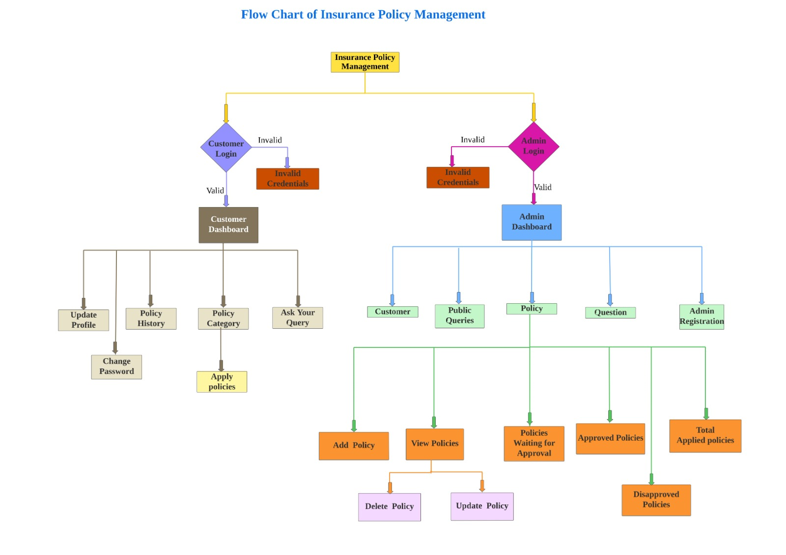



Flow Chart of Insurance Policy Management
21

Slide 22
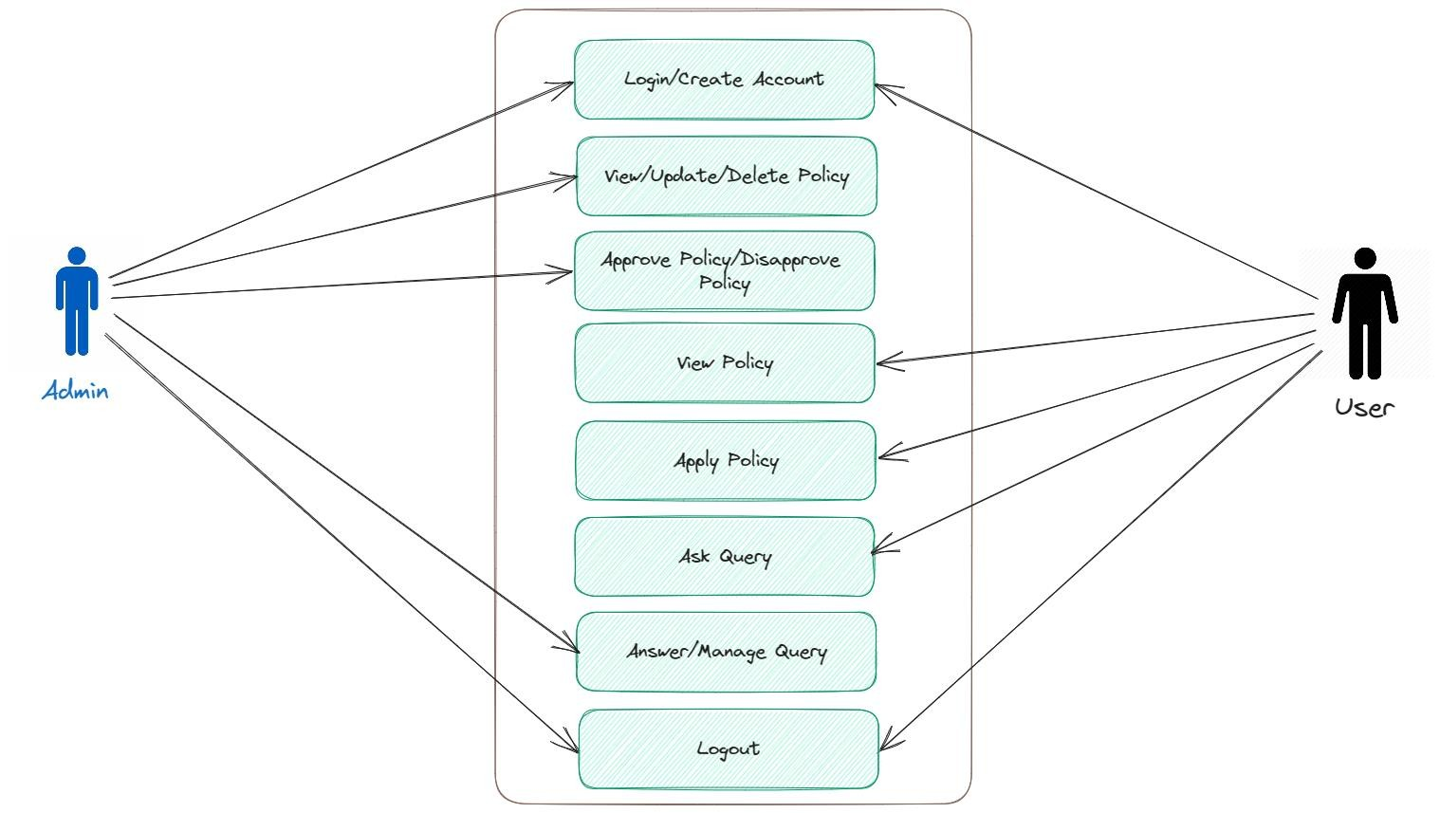
Use case Diagram of Insurance Policy Management

Slide 23
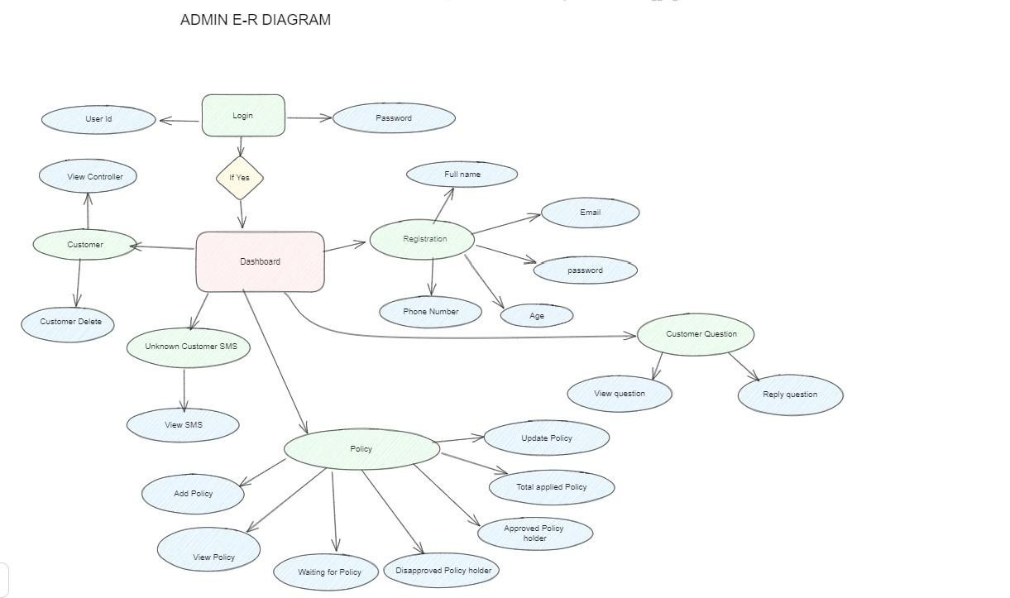
Admin E-R Diagram of Insurance Policy Management

Slide 24
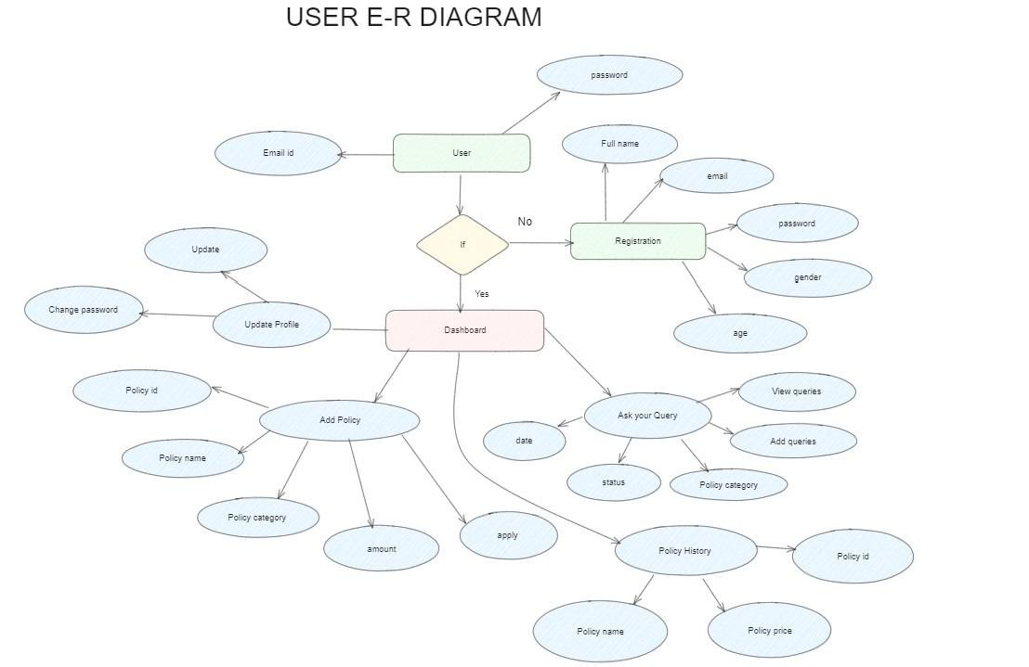
User E-R Diagram of Insurance Policy Management

Slide 25
ADMIN MODULE
Login to the portal.
Create Admin Account .
View/Update/Delete customer.
View/Add/Update/Delete policy category like Life, Health, Motor, Travel.
View/Add/Update/Delete/Approve policy.
View total policy holder, approved policy holder, disapproved policy holder.
Approve policy, applied by customer.
Answer customer question.
View/Delete customer query.

Slide 26
USER MODULE
Create account (no approval required by admin).
Change the password.
Change address, email, mobile.
View all policy that are added by admin.
If customer likes any policy, then they can apply for it.
When customer applies for any policy, it will go into pending status, admin can approve it.
Customer can check status of his policy under history section
Customer can ask question from admin.

Slide 27
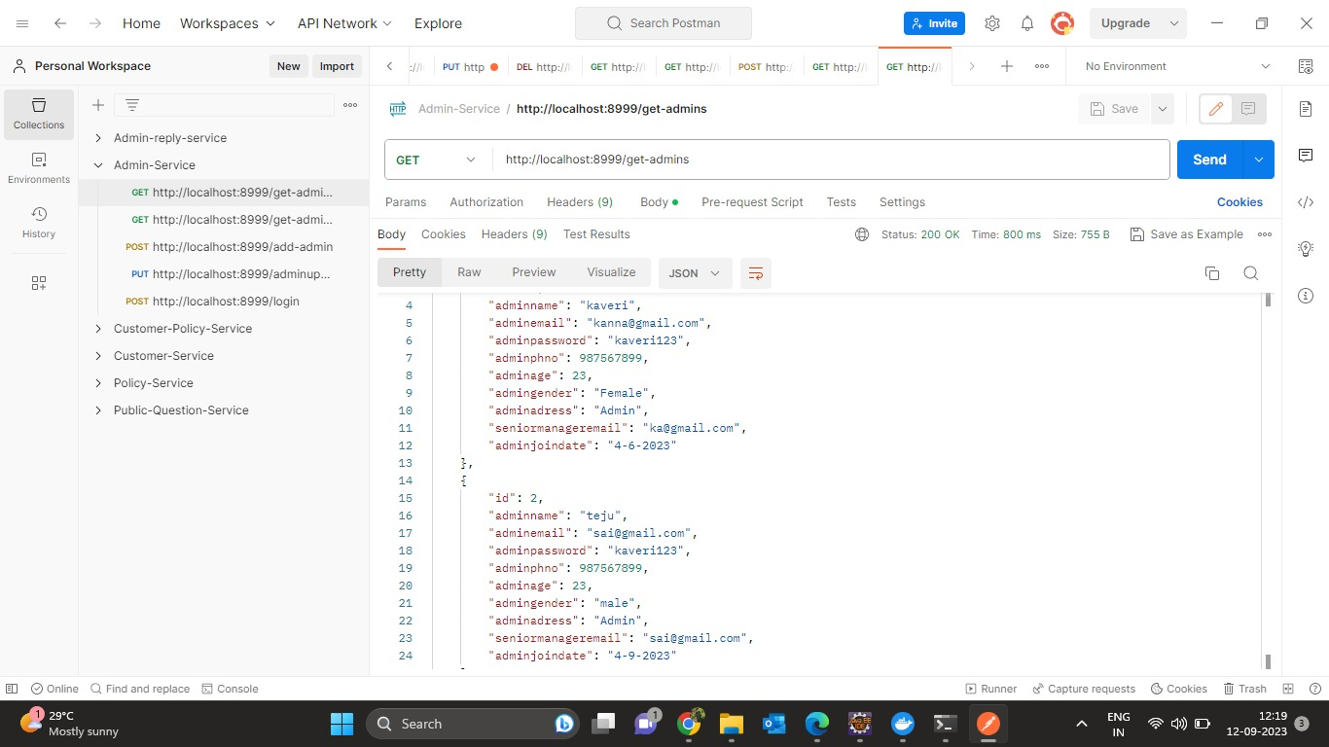
OUTPUT
ADMIN SERVICE

Slide 28
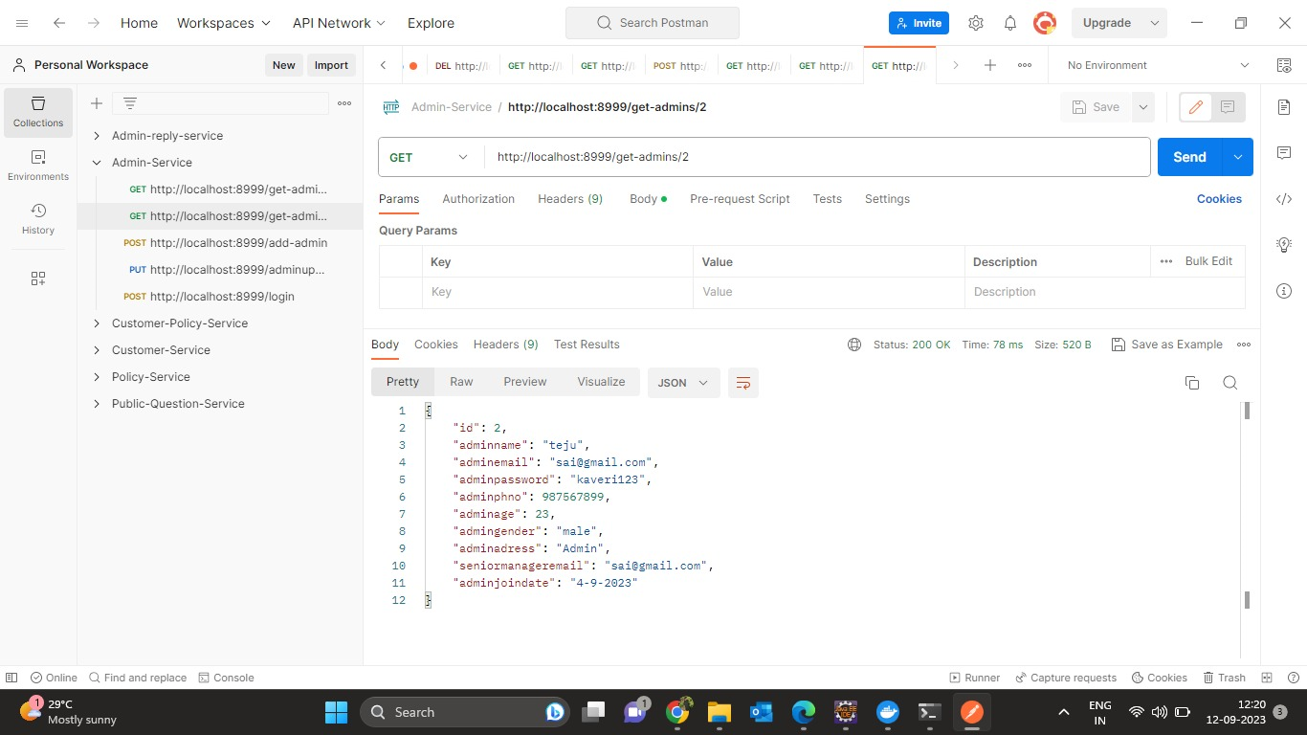

Slide 29
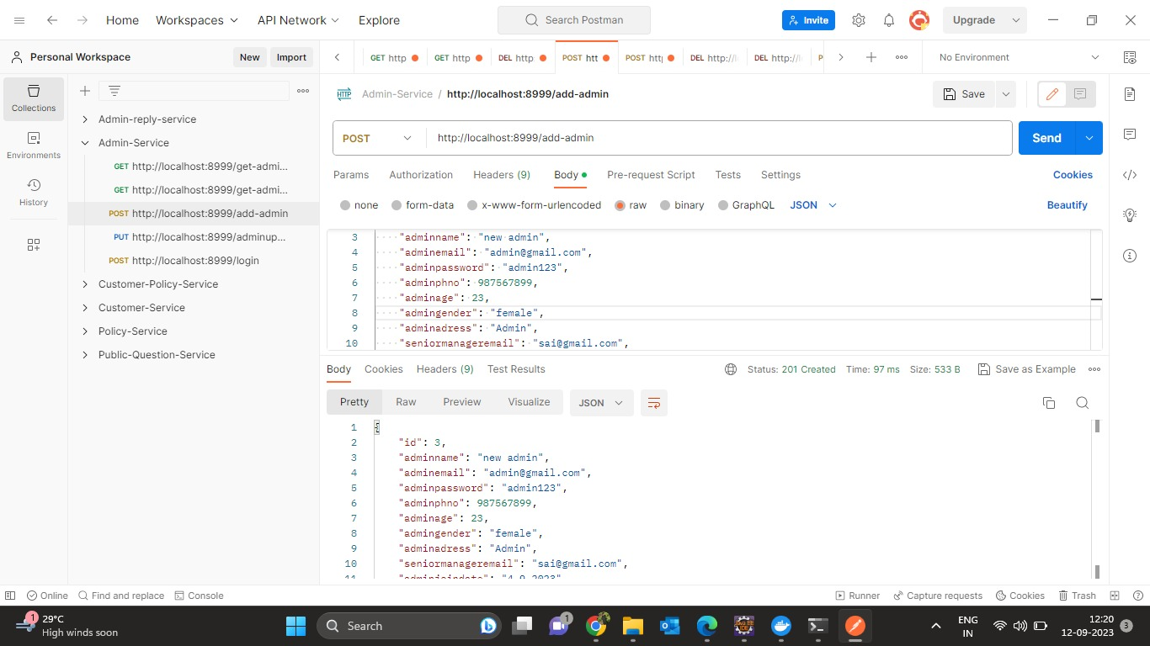

Slide 30
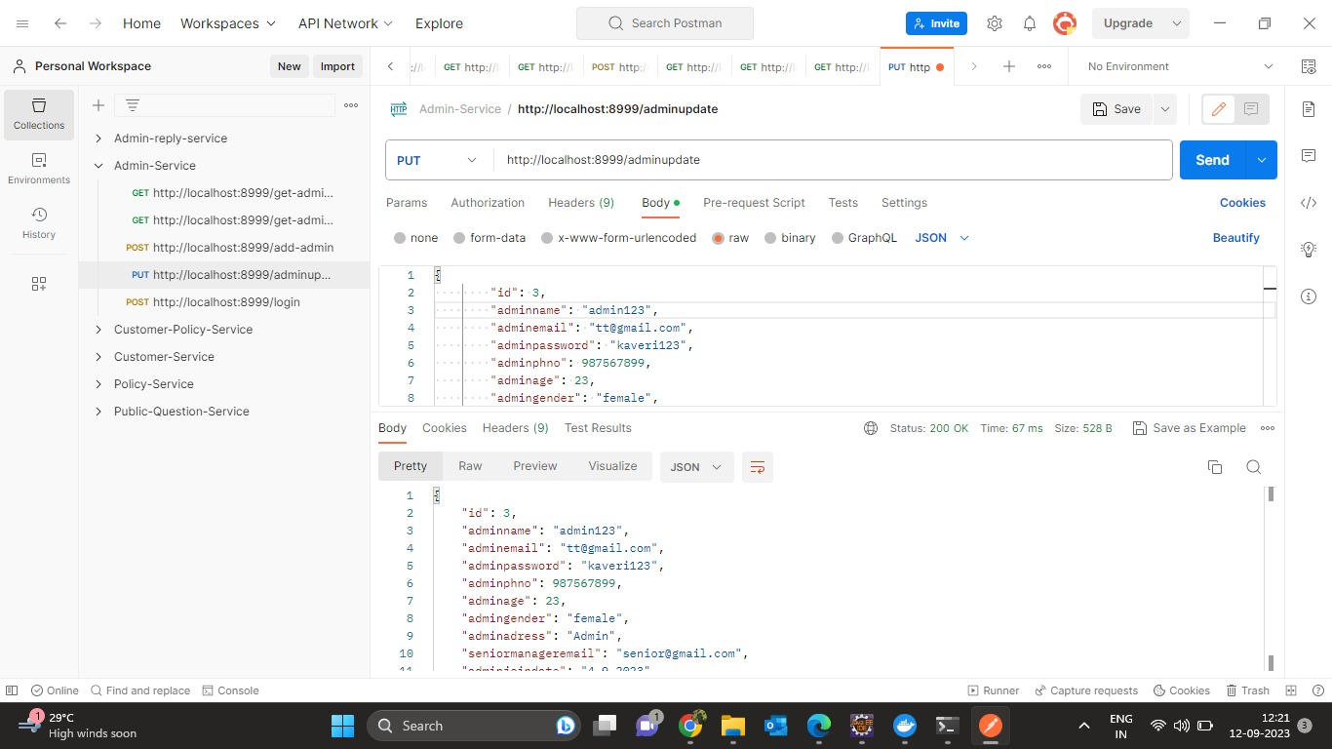

Slide 31
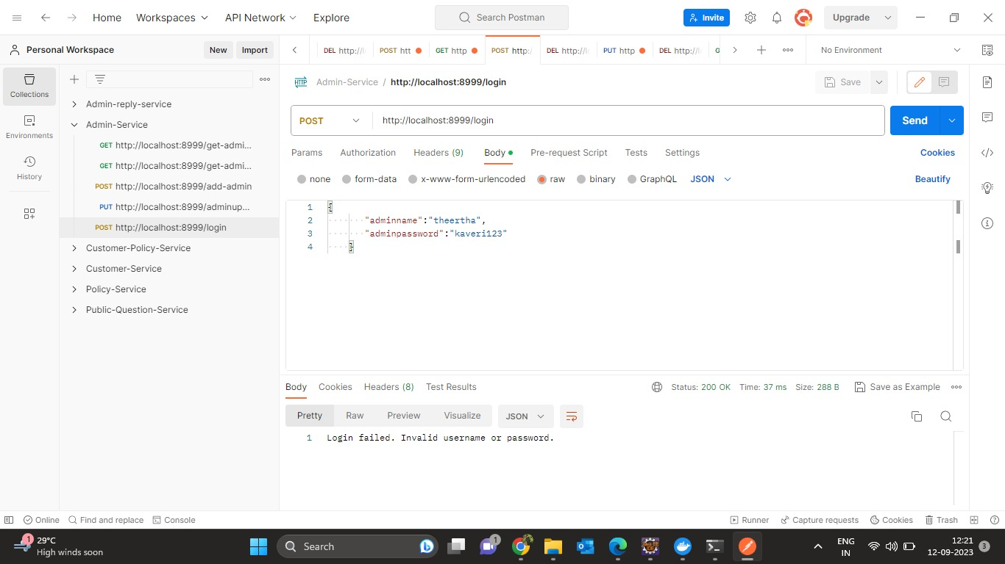

Slide 32
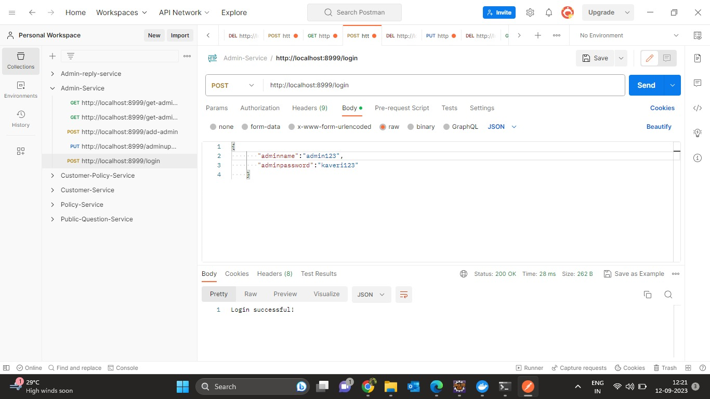

Slide 33
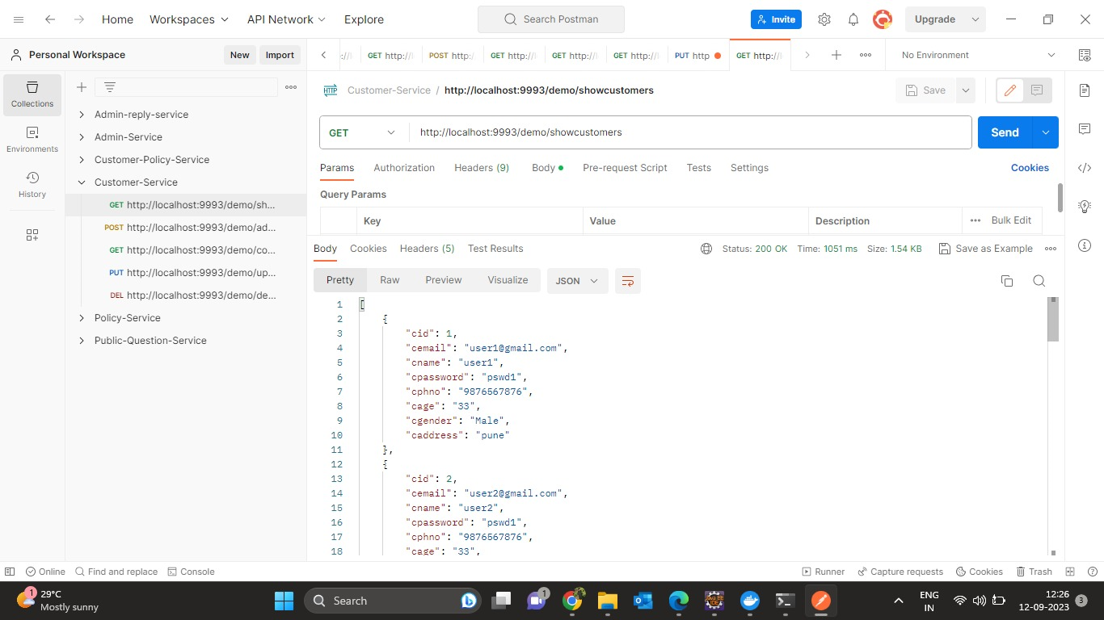
CUSTOMER SERVICE

Slide 34
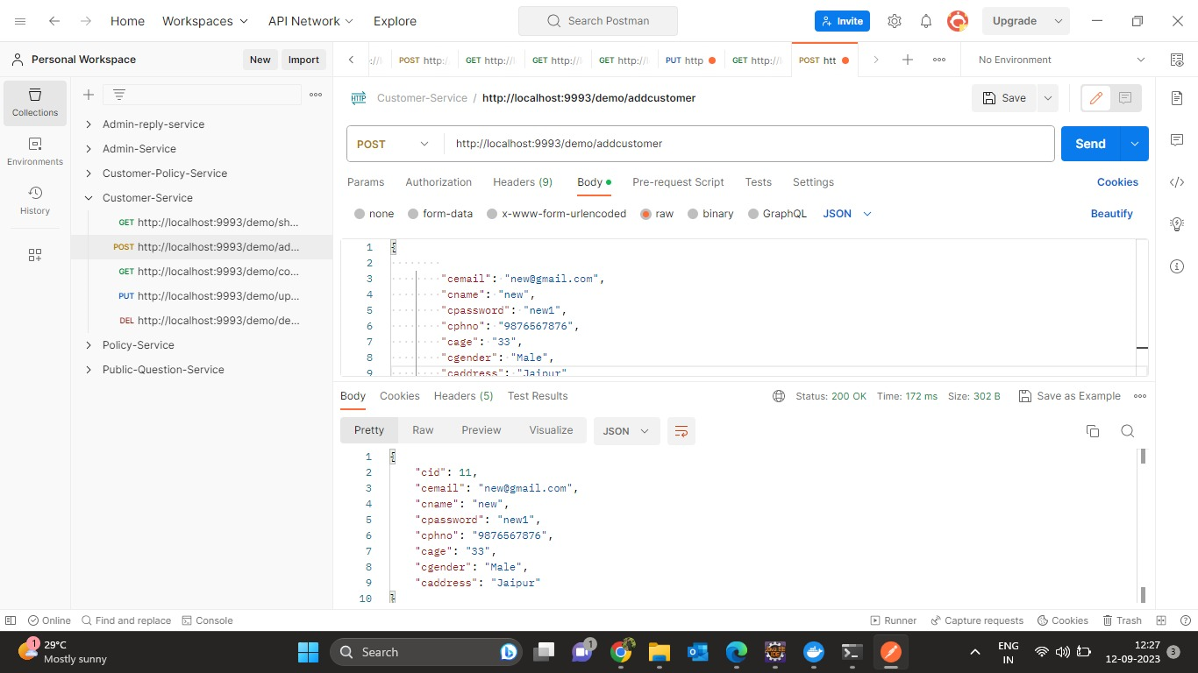

Slide 35
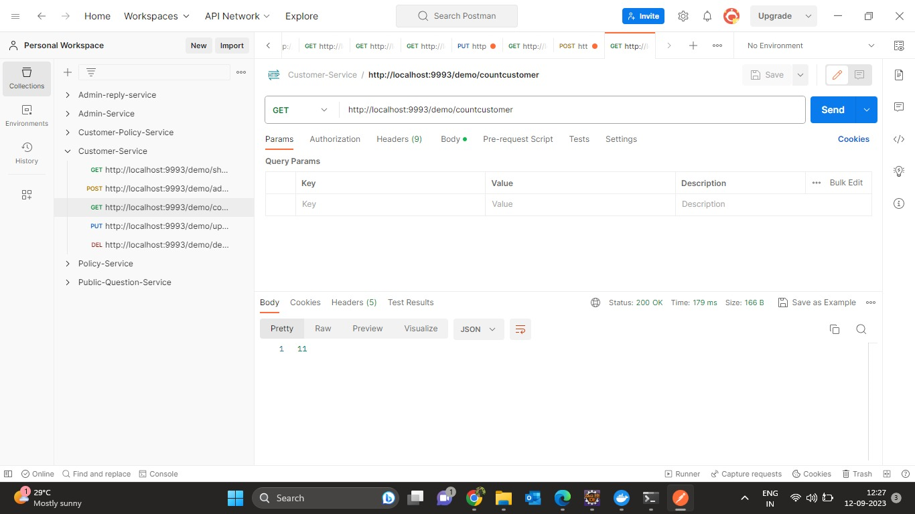

Slide 36
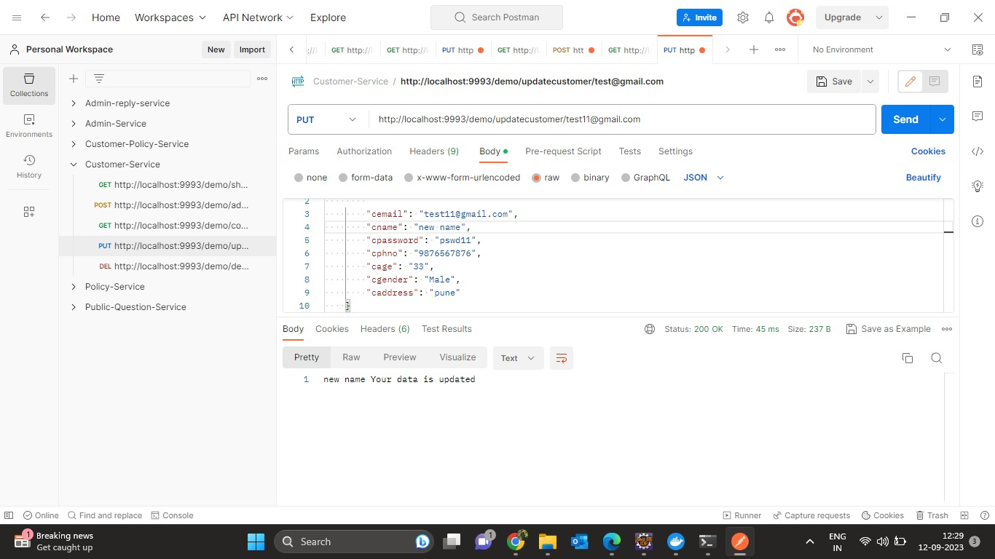

Slide 37
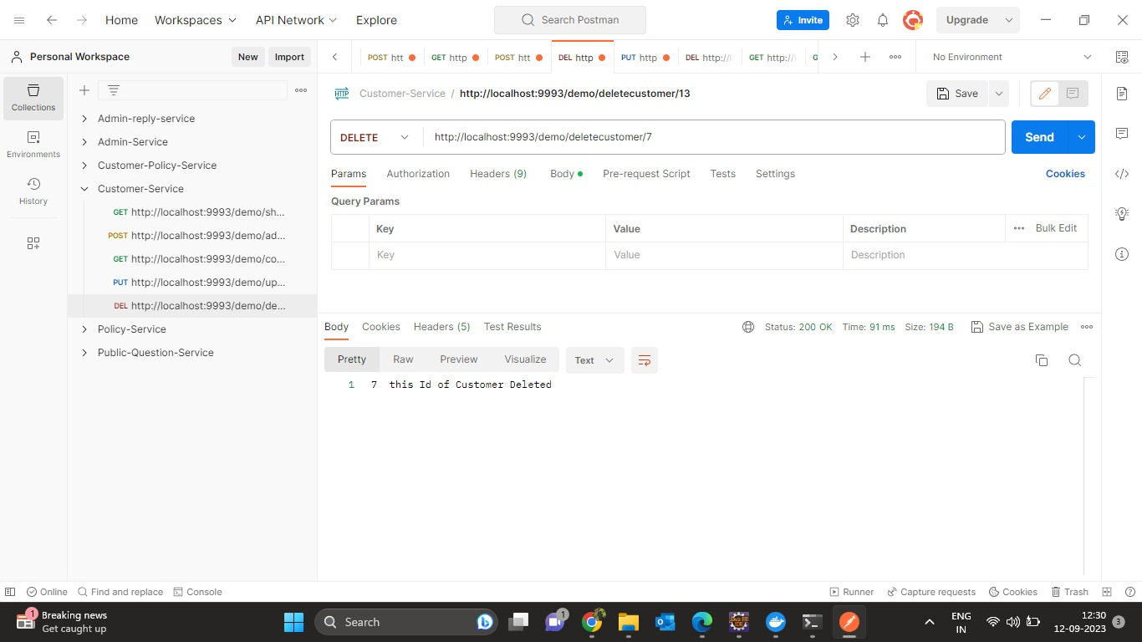

Slide 38
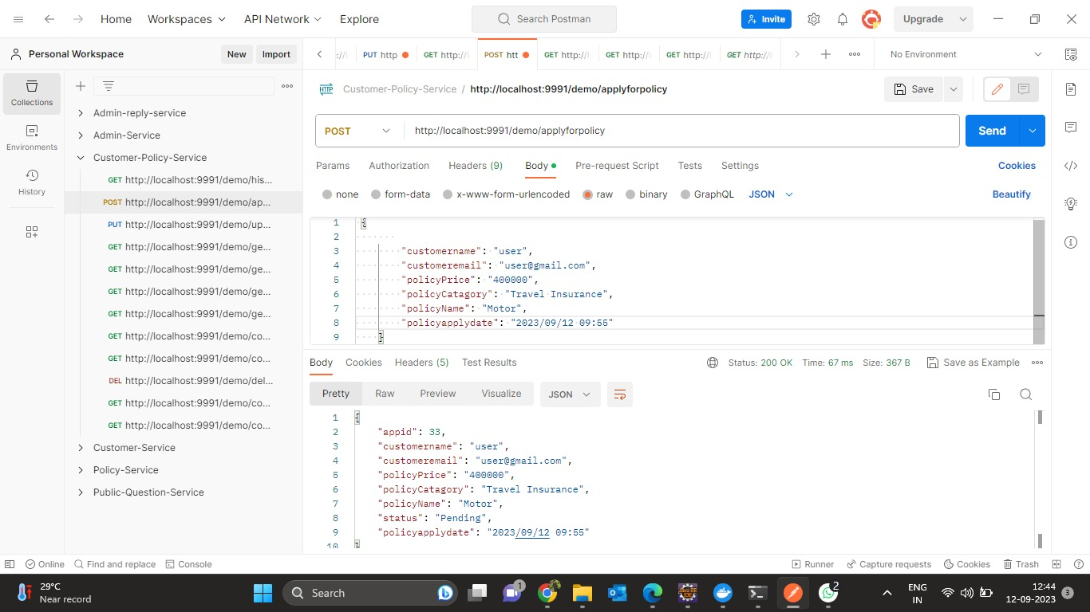
CUSTOMER POLICY SERVICE

Slide 39
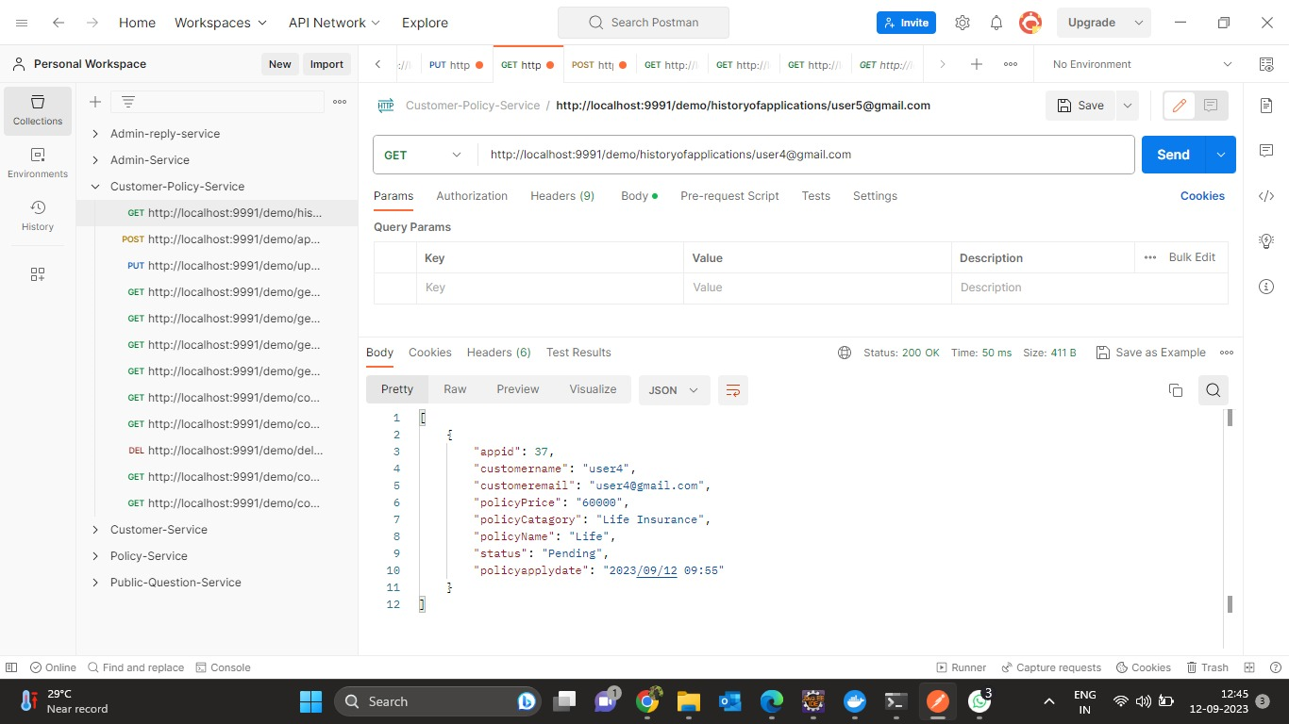

Slide 40
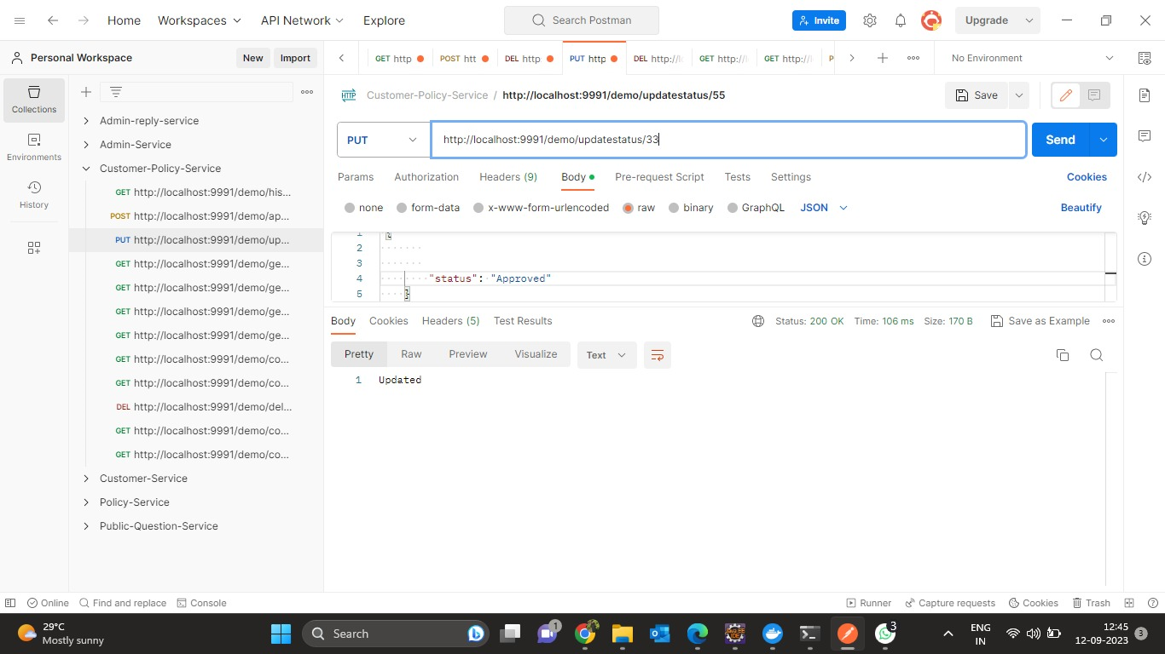

Slide 41
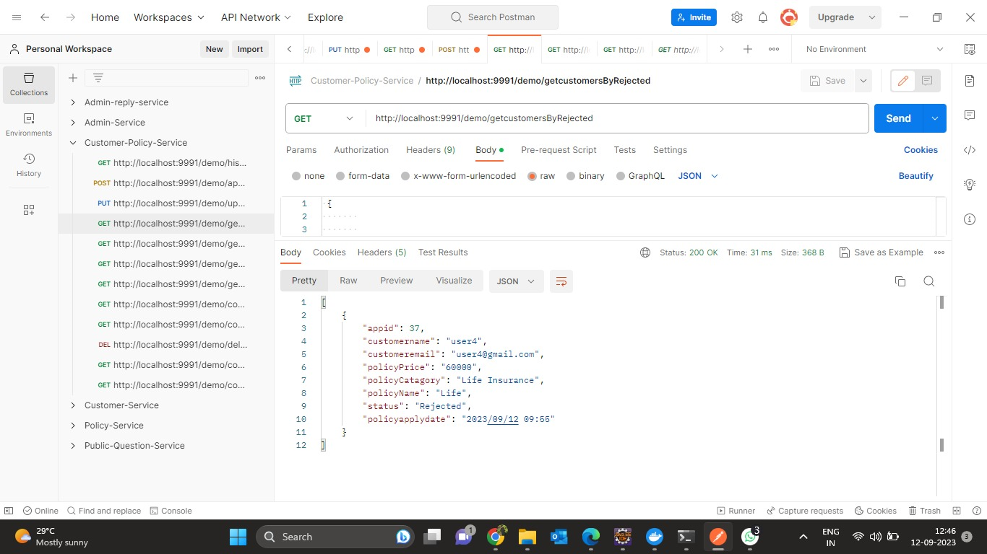

Slide 42
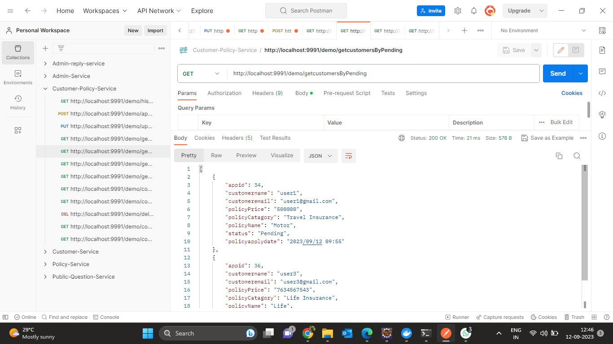

Slide 43
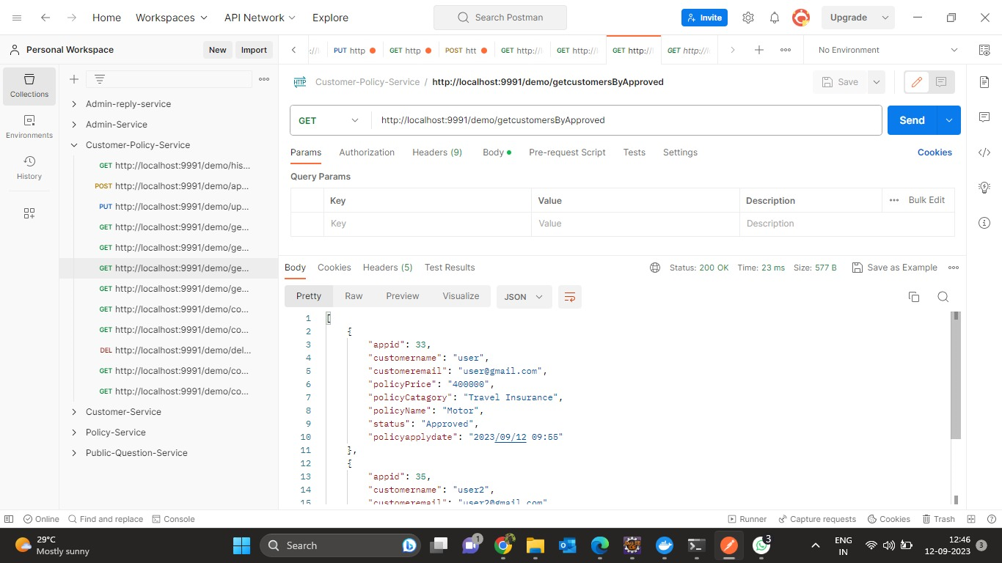

Slide 44
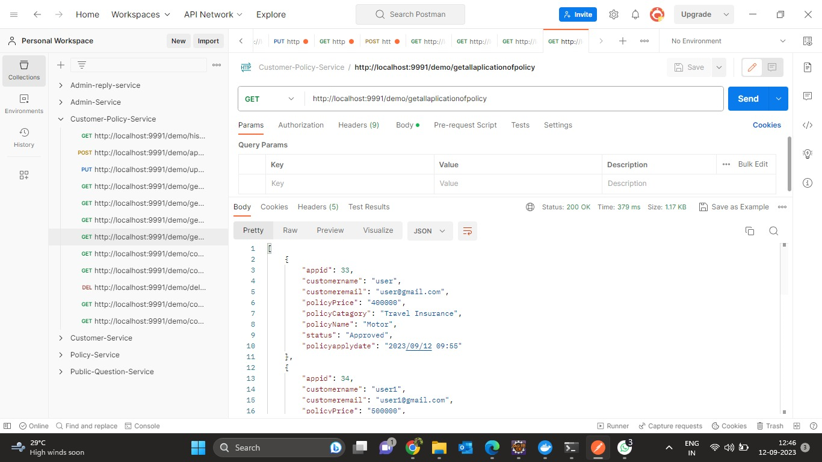

Slide 45
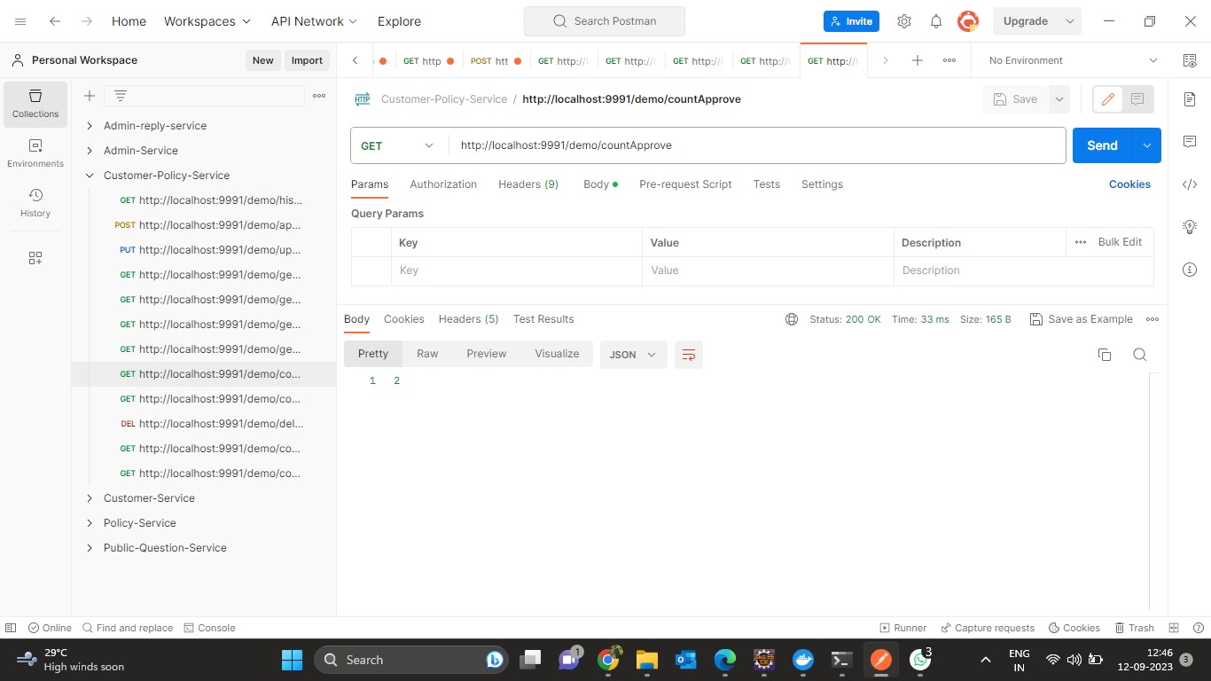

Slide 46


Slide 47
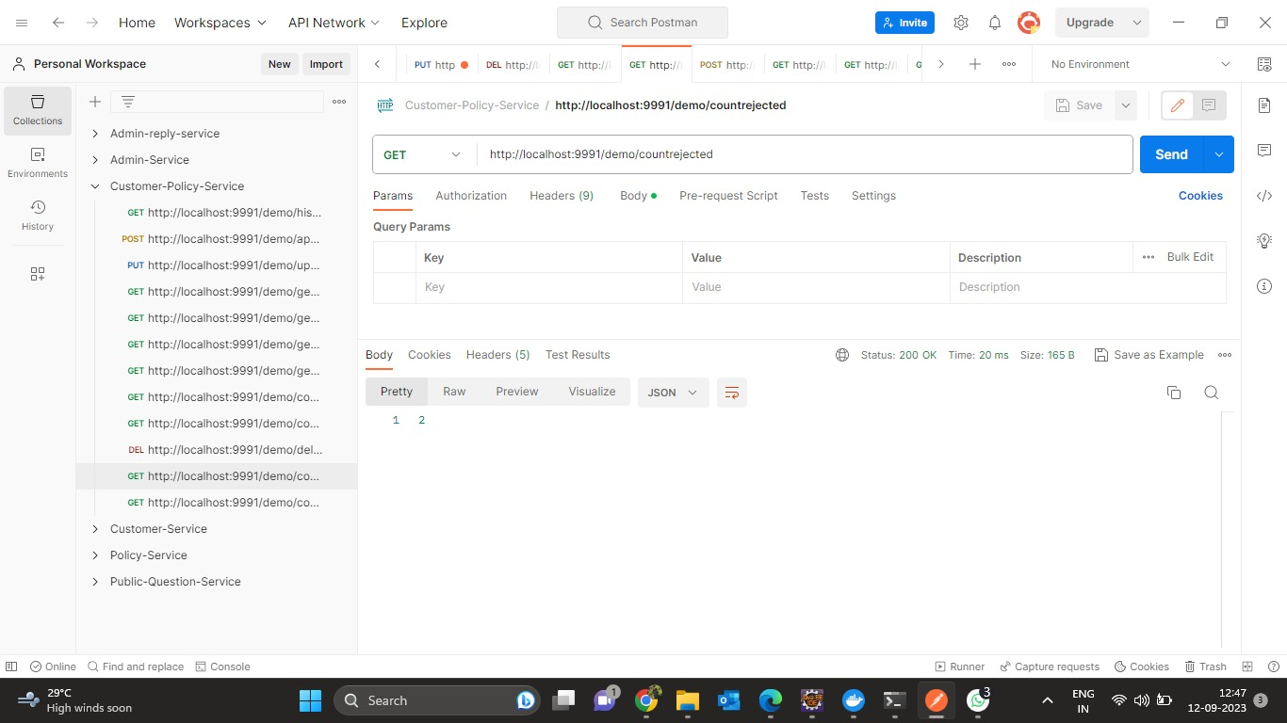

Slide 48


Slide 49


Slide 50
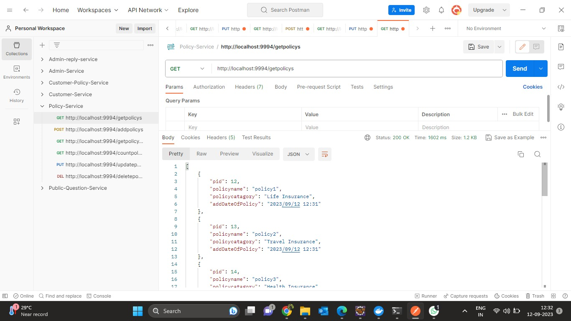
POLICY SERVICE

Slide 51
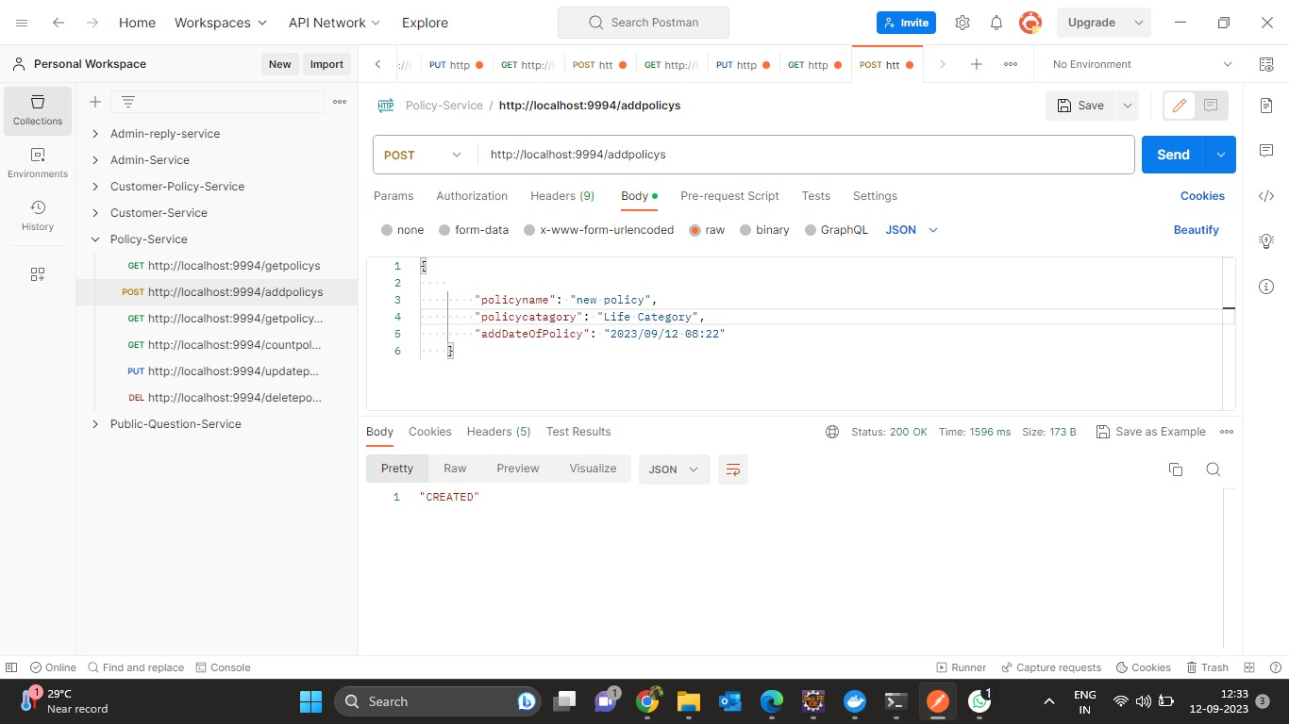

Slide 52
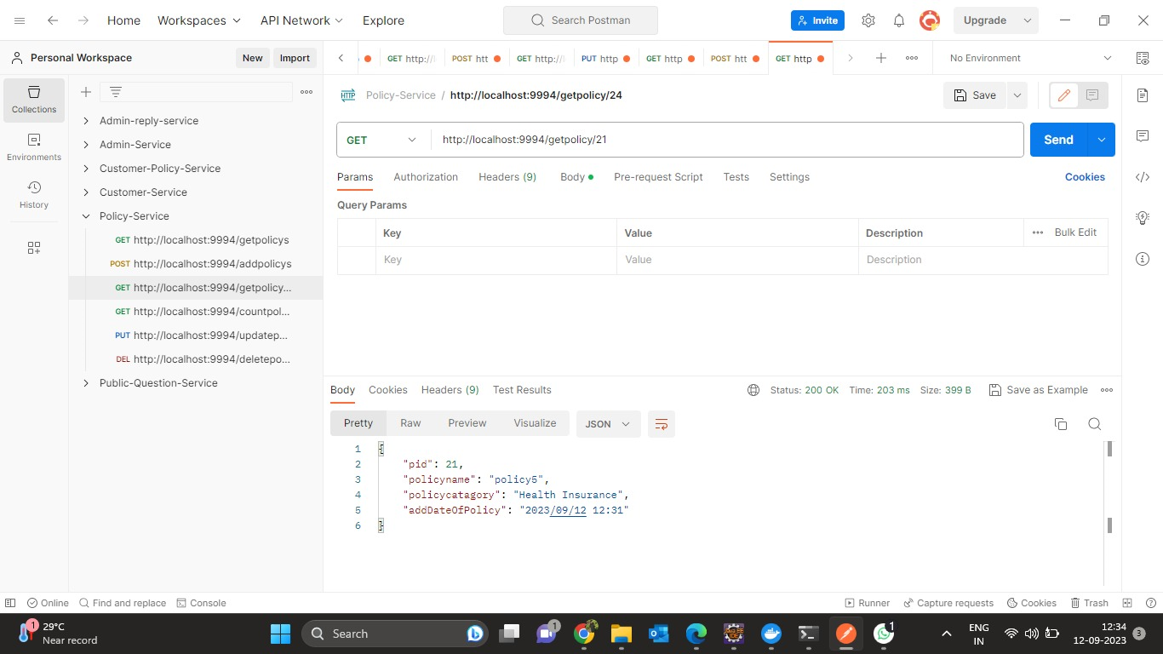

Slide 53
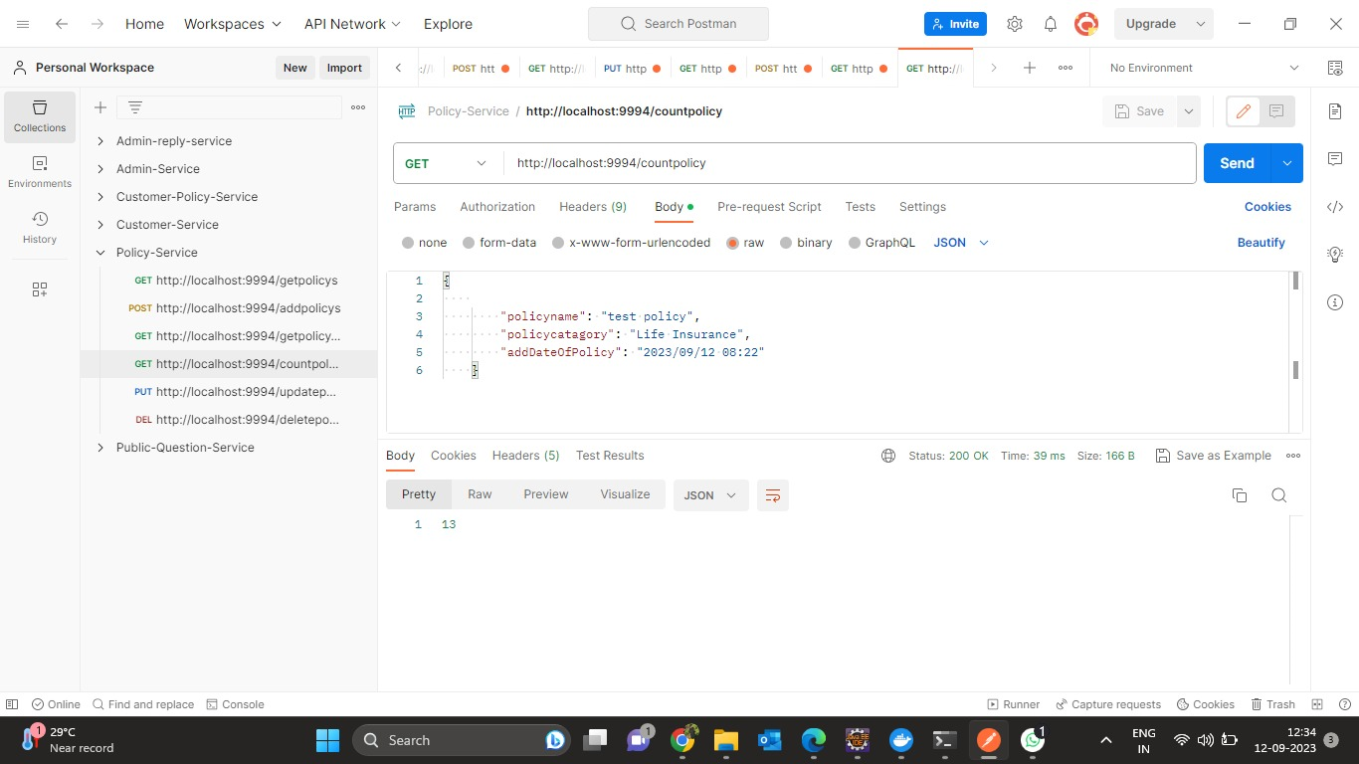

Slide 54


Slide 55
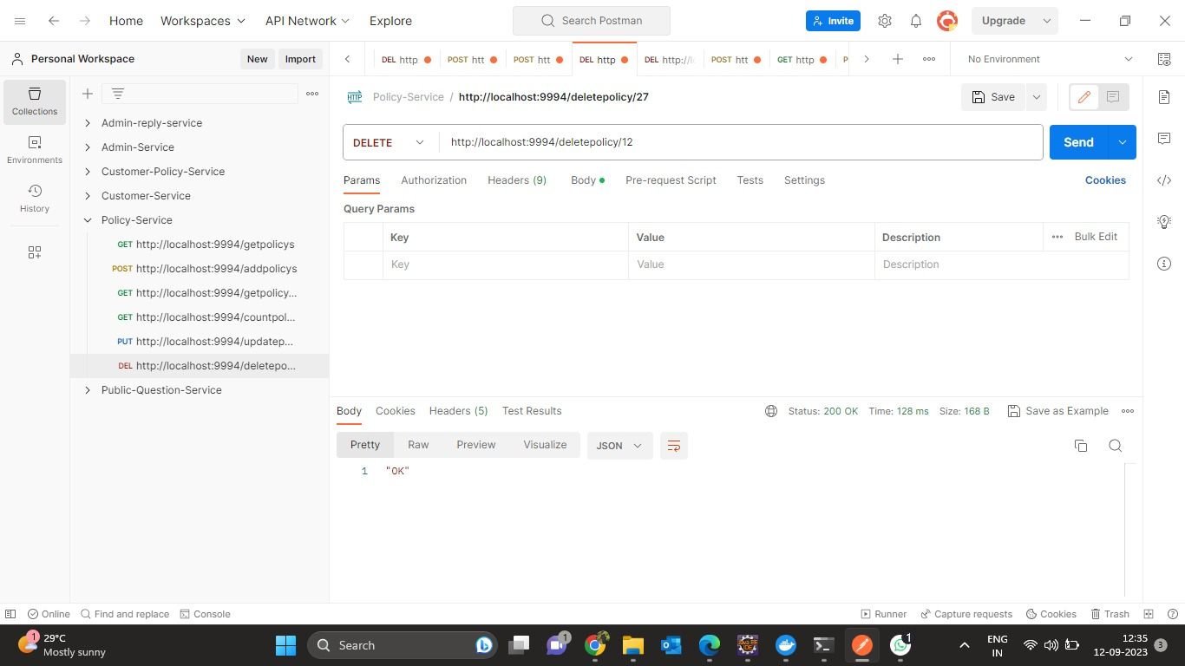

Slide 56
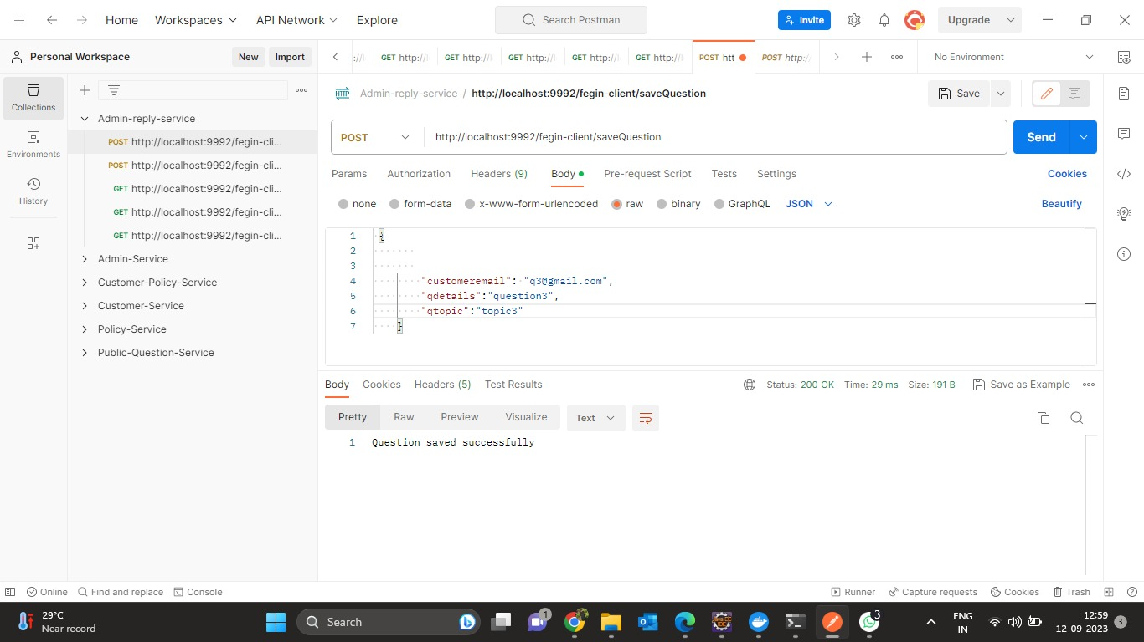
QUESTION REPLY SERVICE

Slide 57
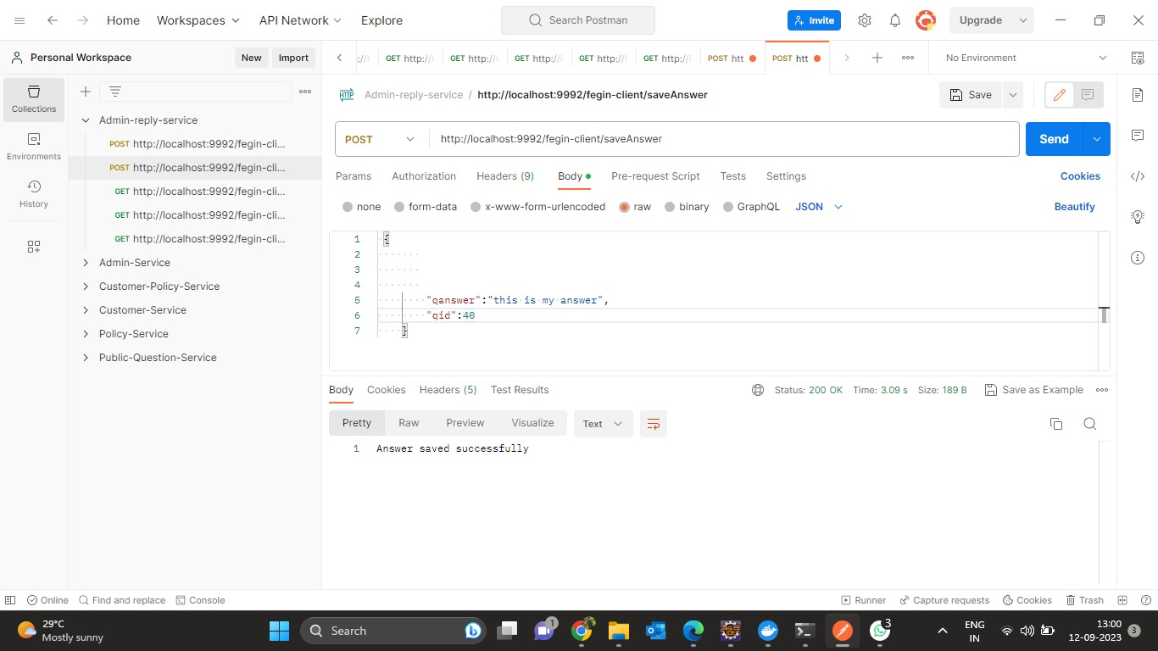

Slide 58
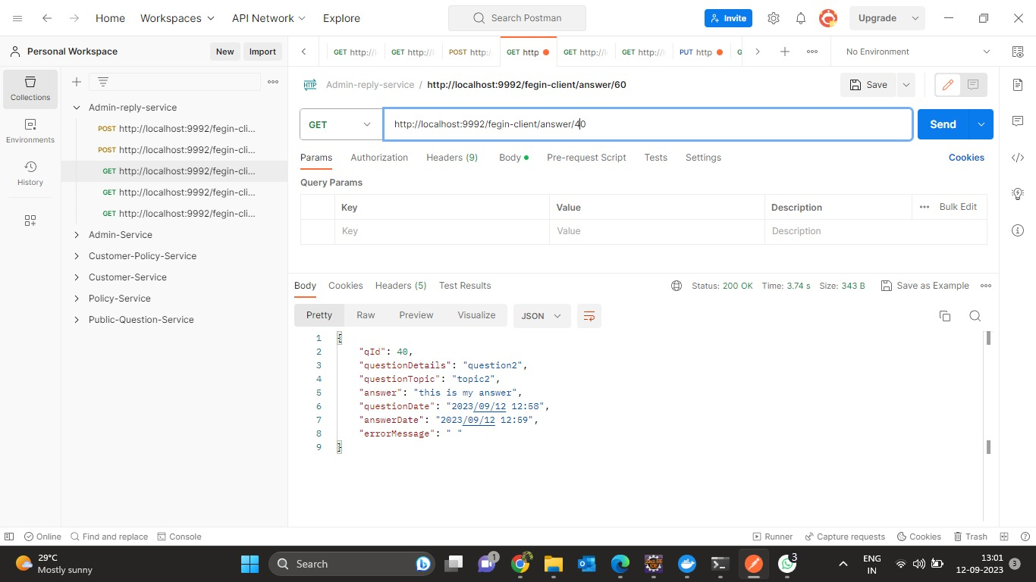

Slide 59
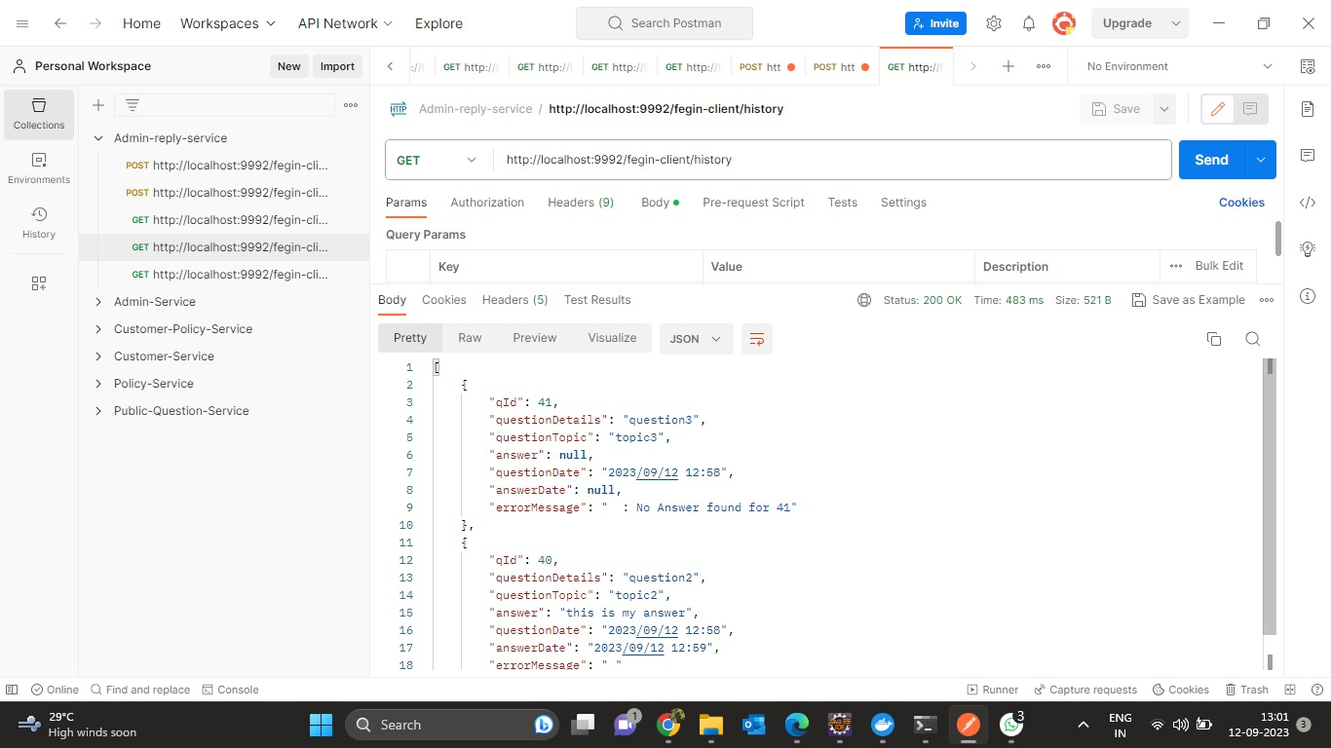

Slide 60
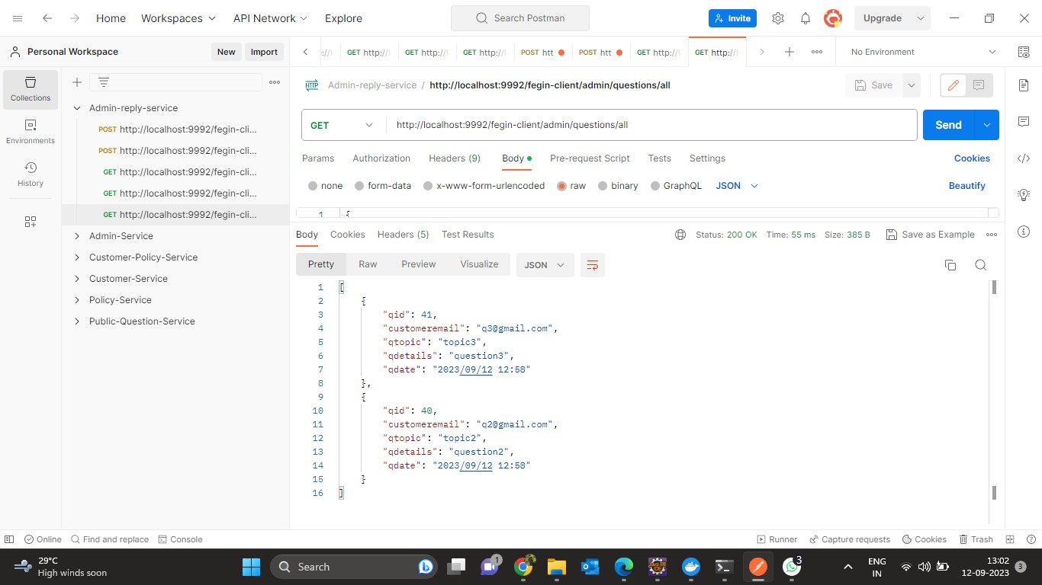

Slide 61
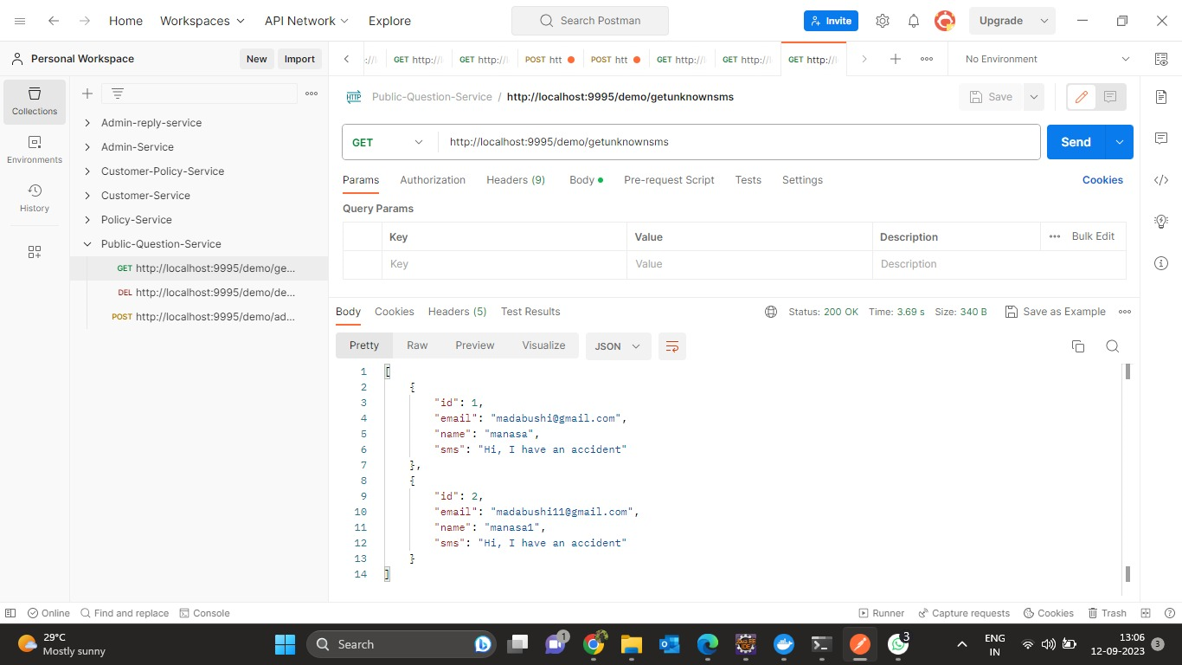
PUBLIC QUESTION SERVICE

Slide 62
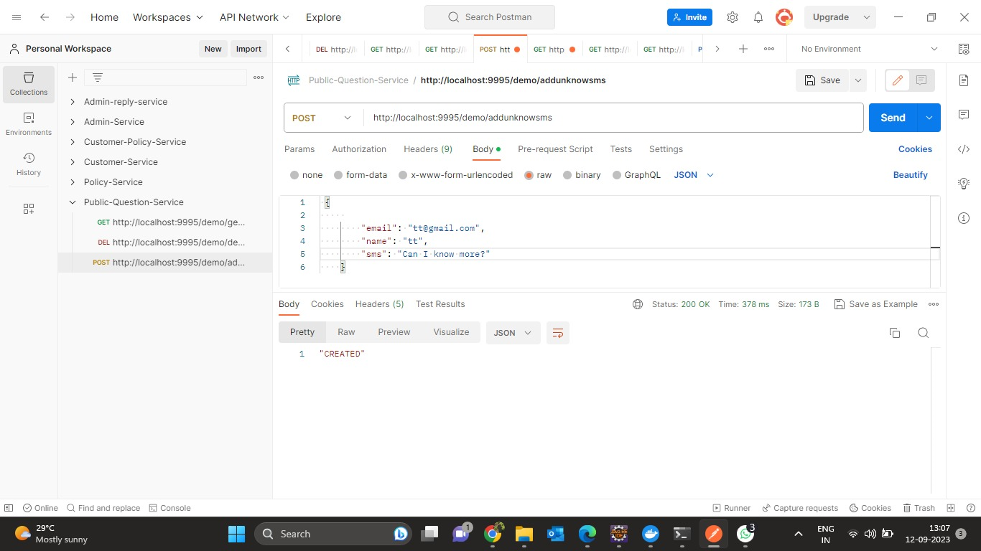

Slide 63
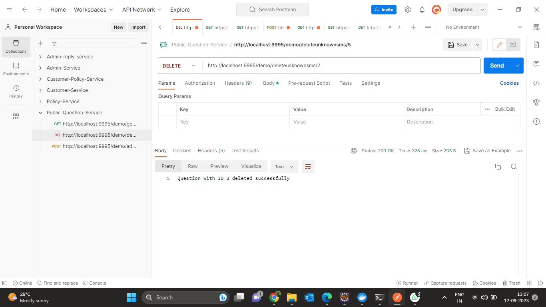

Slide 64
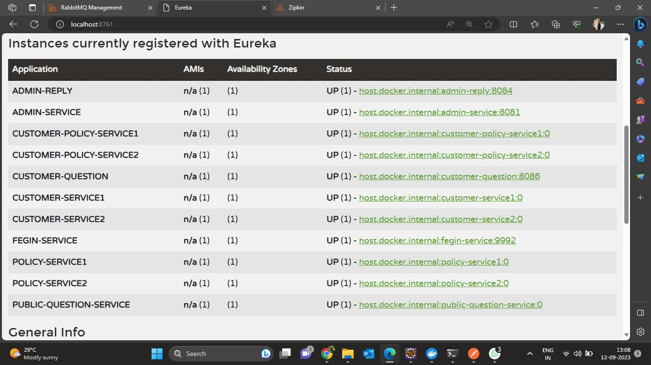
EUREKA SERVER

Slide 65
FUTURE SCOPE
Developed to be used by the all the people.
Can be used by the students for study purpose.
It eradicates the fake policy providing websites.
Keeps the capability to centralize all the insurance industry in India and shall keep transparency in industry.
This project can bring a revolution in the insurance industry.

Slide 66
Advantages
Provides economic protection
Shares Risks
Maintain Standards of Living
Encourage Savings
Eliminate dependency

Slide 67
Disadvantages
Fraud Agencies
Not for all People
Can be Expensive

Slide 68
LET’S MOVE TO OUR PROJECT

Slide 69
THANK YOU

